Slide 1
Car Gas Mileage Calculator
Done by,
Devi Prasad
Santosh gandhi
Mourya praharsha
Vinay chandra

Slide 2
Problem Statement
Car mileage is one of the statistics car owners use.
Because newer cars come with such features, we can develop an app that can be used by older cars.
It can give users a way to calculate their car mileage based on the car driven and the gas added to the car.

Slide 3
Features
App has the functionality to input the gas that can e filled by users.
Miles travelled need to be either measured or provide entries.
The data is stored in local database.

Slide 4
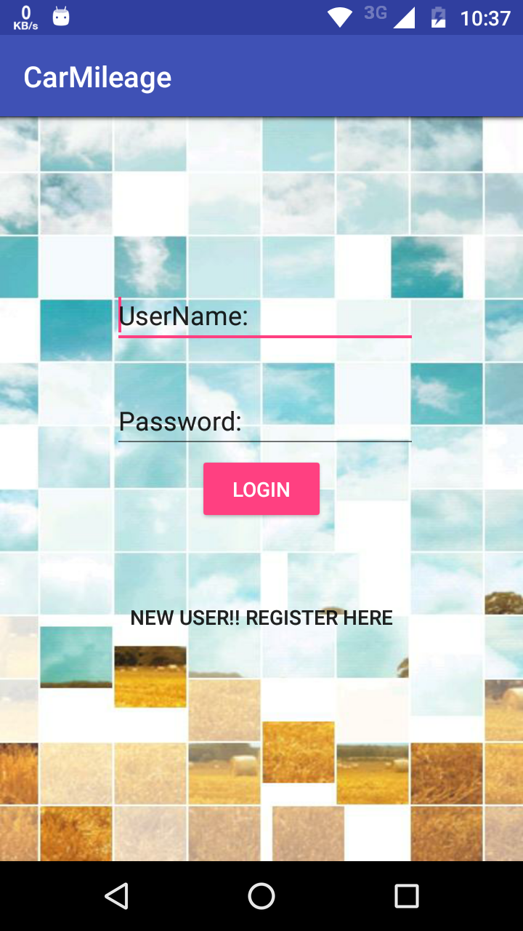
Login Page
User can login into the app by providing username and password.

Slide 5
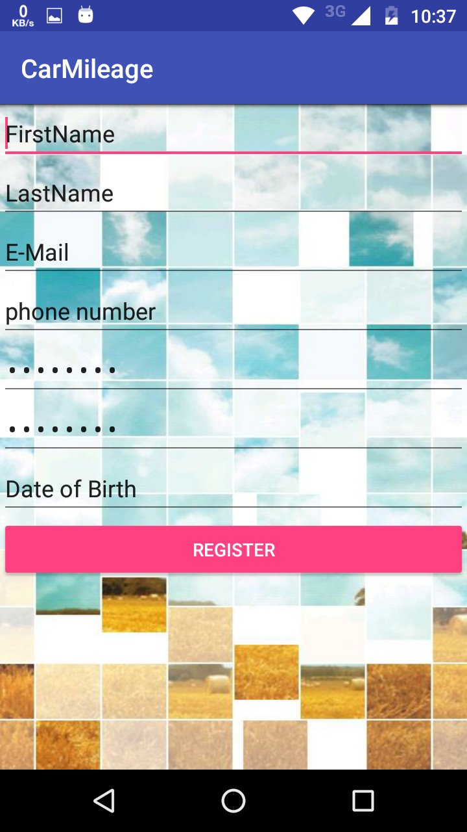
Registration Page
If user is not registered , he can register by clicking New user button, so that registration page opens, and user can provide the details.

Slide 6

Home page
User can enter the travel details, so that he can get the mileage details.

Slide 7
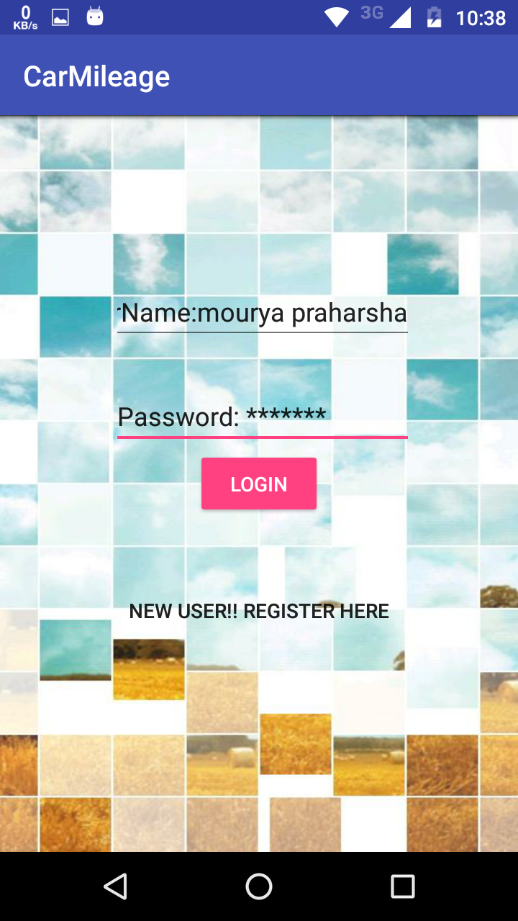
Login Page
After user enter the login details

Slide 8
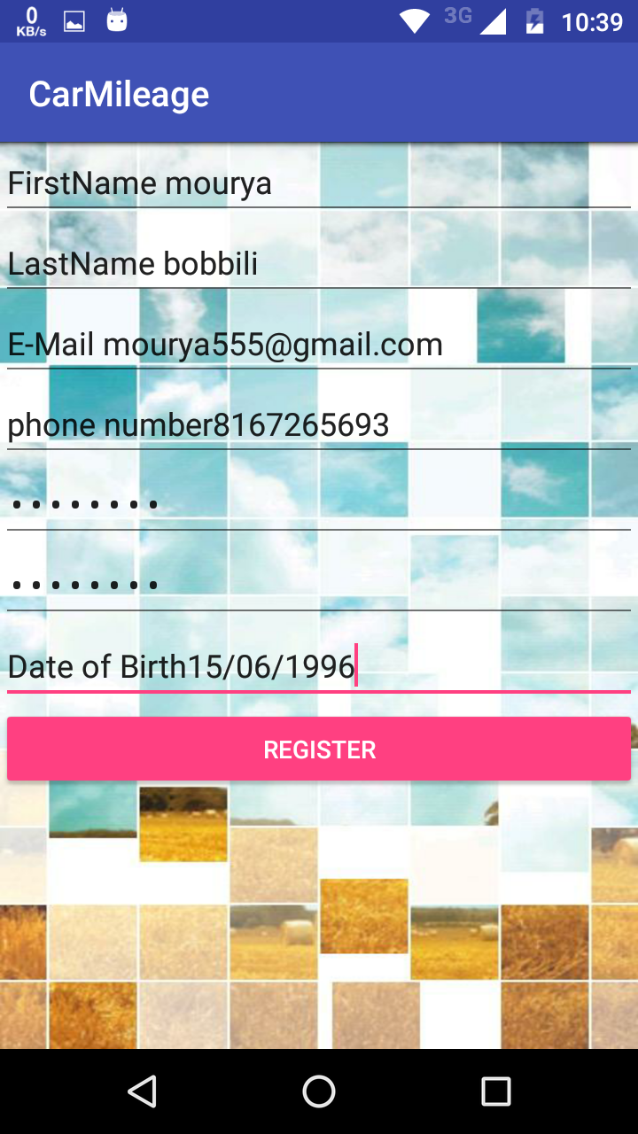
Registration Page
After user enter his details.

Slide 9
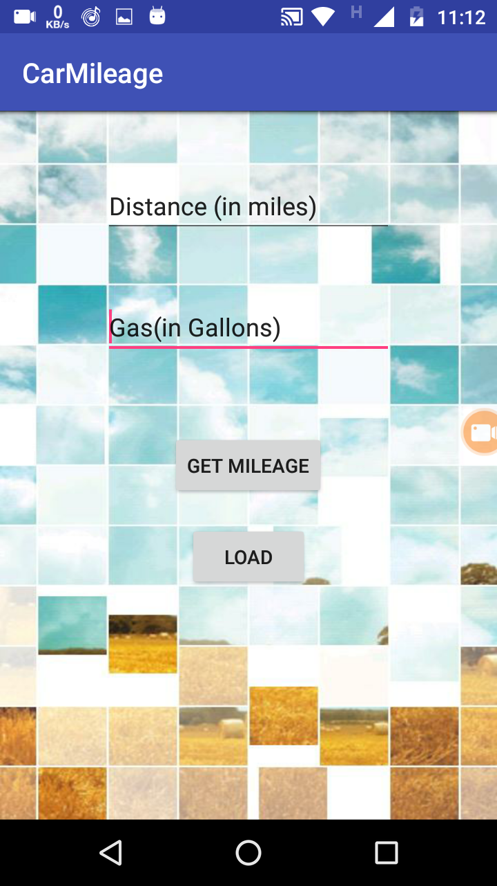
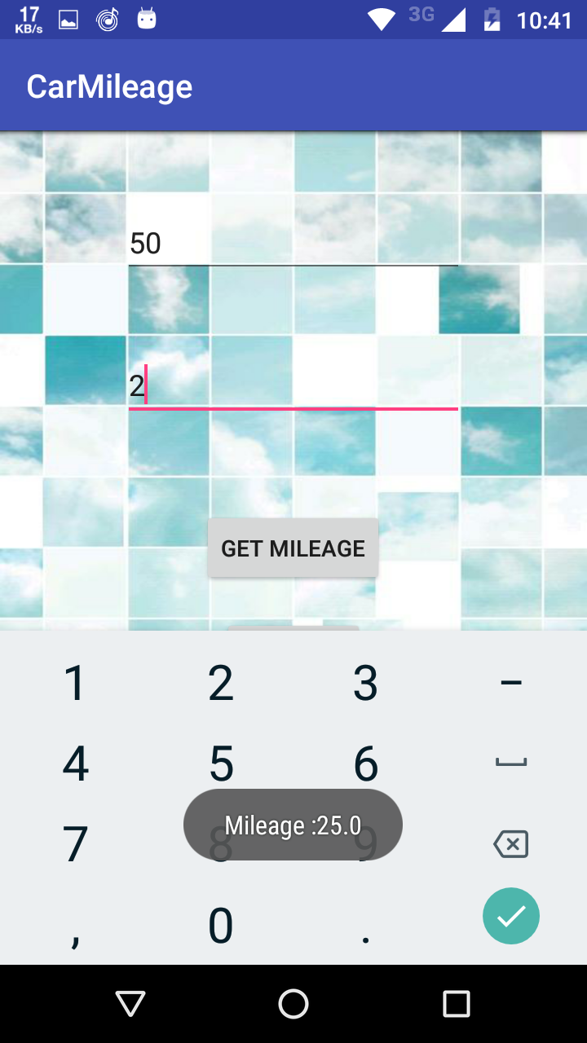
Home page
User has to provide miles and gas details in the app, so that he can get mileage
Distance – 50, Gas - 2

Slide 10
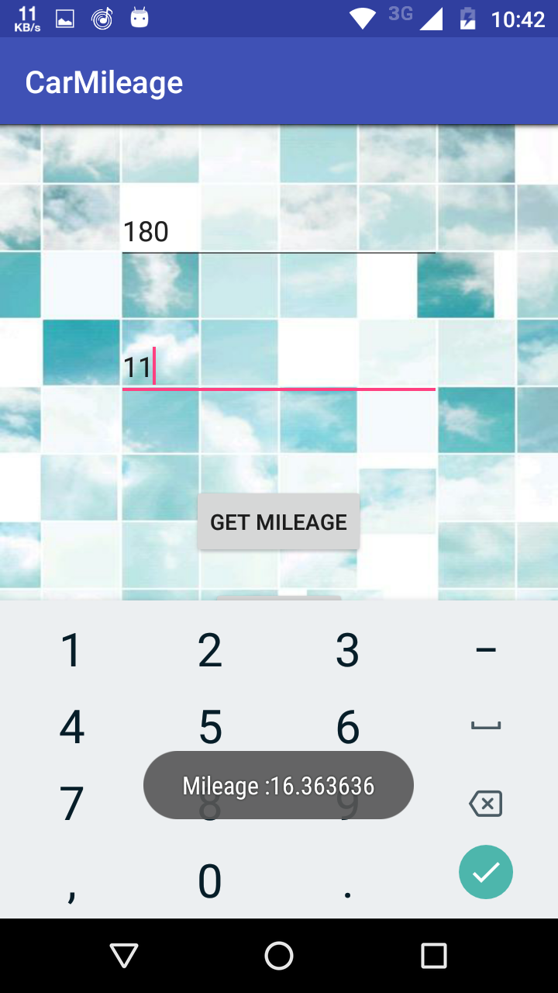

Few sample examples

Slide 11
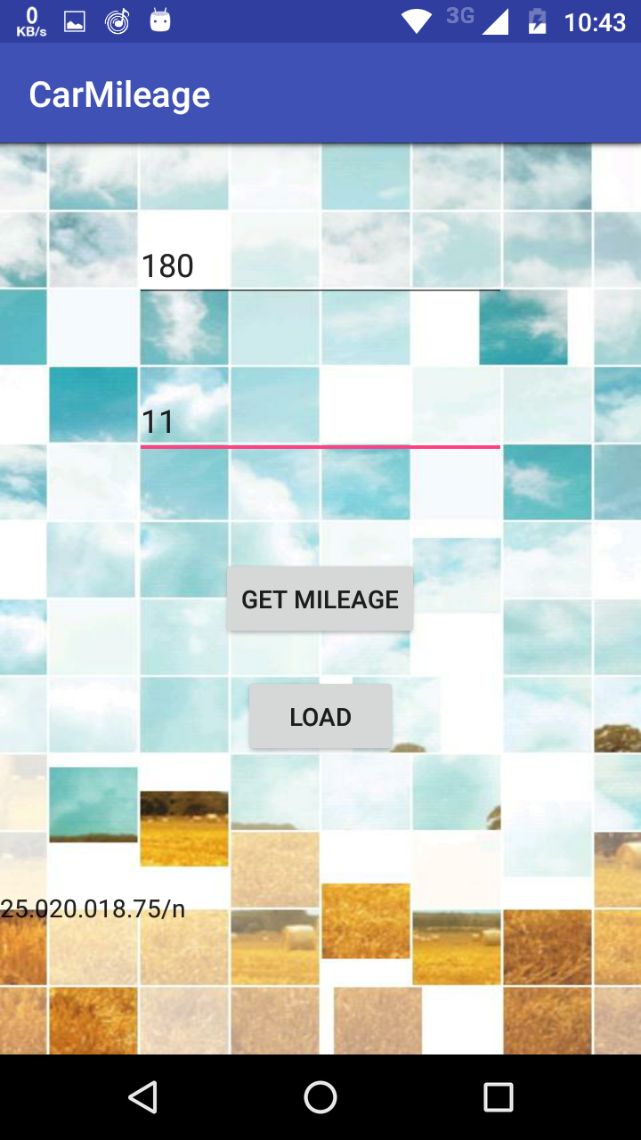

Few Examples
Distance – 180, Mileage-11
Distance – 100, Mileage-5

Slide 12
THANK YOU

